Slide 1
Recipe Sharing Platform
CS 312 Group Project
Team Members:
1. Mitchell Morris
2. Braydon Lamoreaux
3. Tyler Edwards

Slide 2

Agenda
01
Problem Statement & Idea
02
Project Components
03
Phase - 1 and Phase - 2 Deliverables
04
Challenges and Solutions
05
Project Demo

Slide 3

Problem Statement & Idea
There is a need for a community-driven platform where people can share, discover, and interact with various recipes, tailored to different dietary preferences and cuisines. We will develop a recipe-sharing website that allows users to upload recipes, search by specific ingredients or cuisine, and interact with other users through ratings and comments.

Slide 4

Project Components
Recipe Submission Form
Search and Filter Functionality
Recipe Rating and Commenting System
User Profiles and Saved Recipes
Notes:
1. Allows users to submit new recipes with fields for title, ingredients, instructions, and tags for dietary preferences.
Includes options for uploading photos, cooking times, and difficulty levels.
Users can categorize recipes by cuisine or meal type
2.

Slide 5
Phase – 1 Deliverables
Recipe Submission Form
Search Feasibility
User Profile Setup
Recipe Rating System

Slide 6
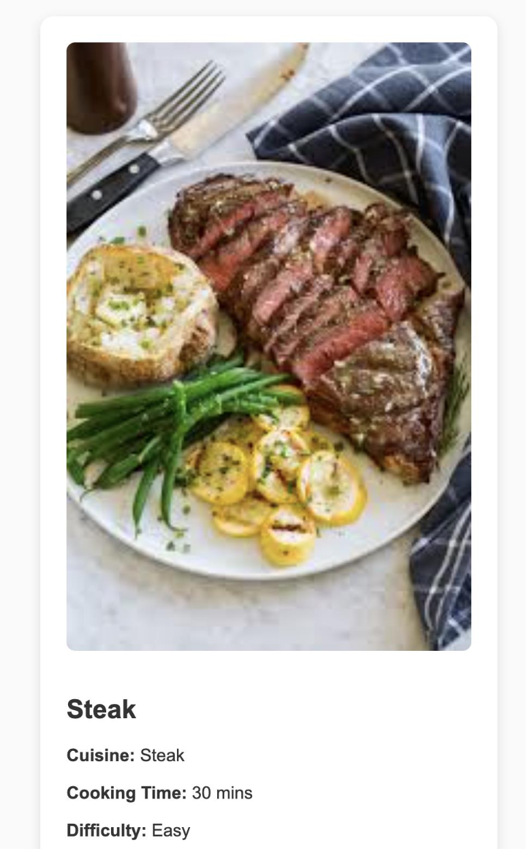
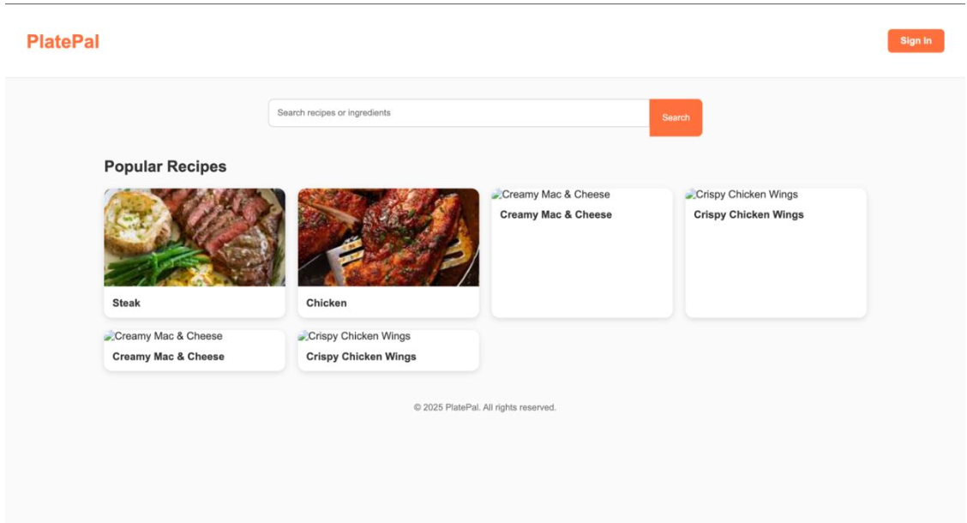
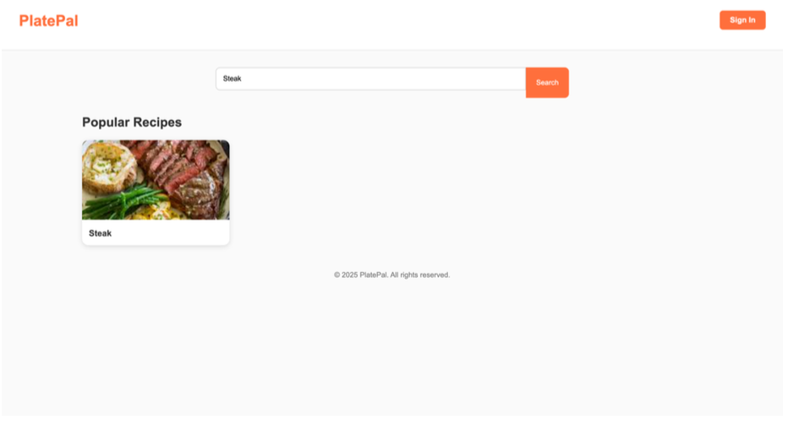
Phase – 1 Deliverables Contd.

Slide 7
Phase – 2 Deliverables
Enhanced platform with commenting
Advanced Filters
Recommendations
Polished UI

Slide 8
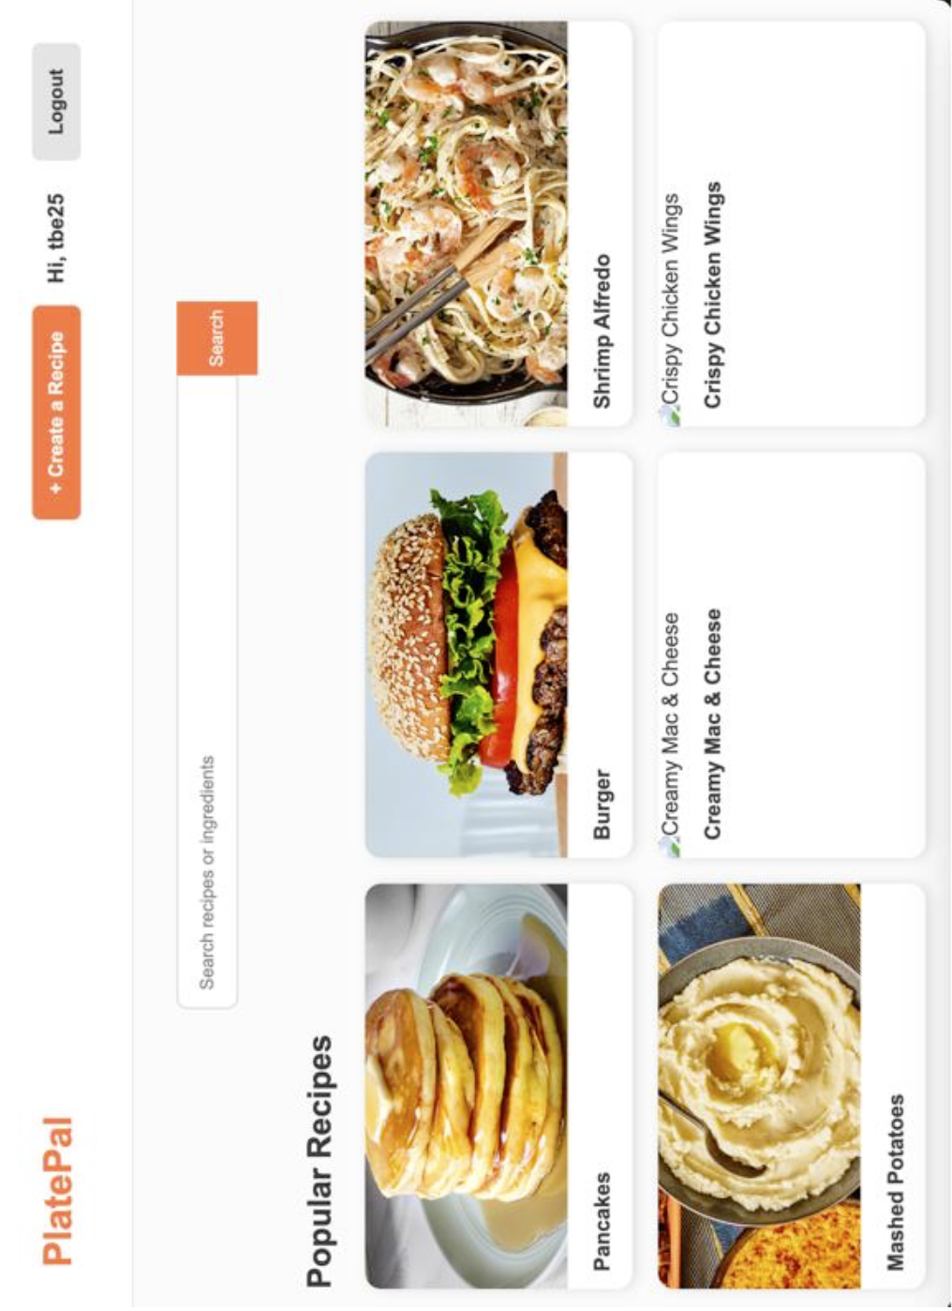
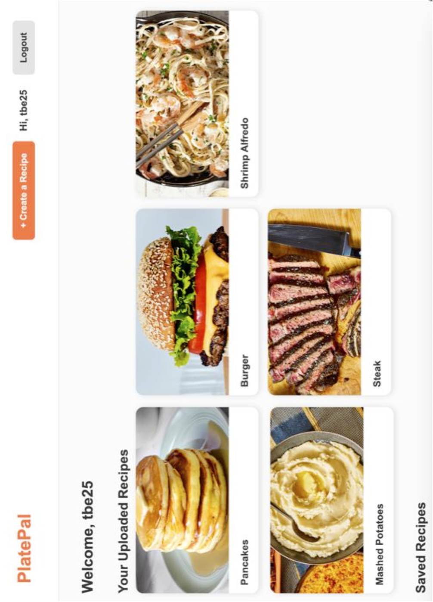
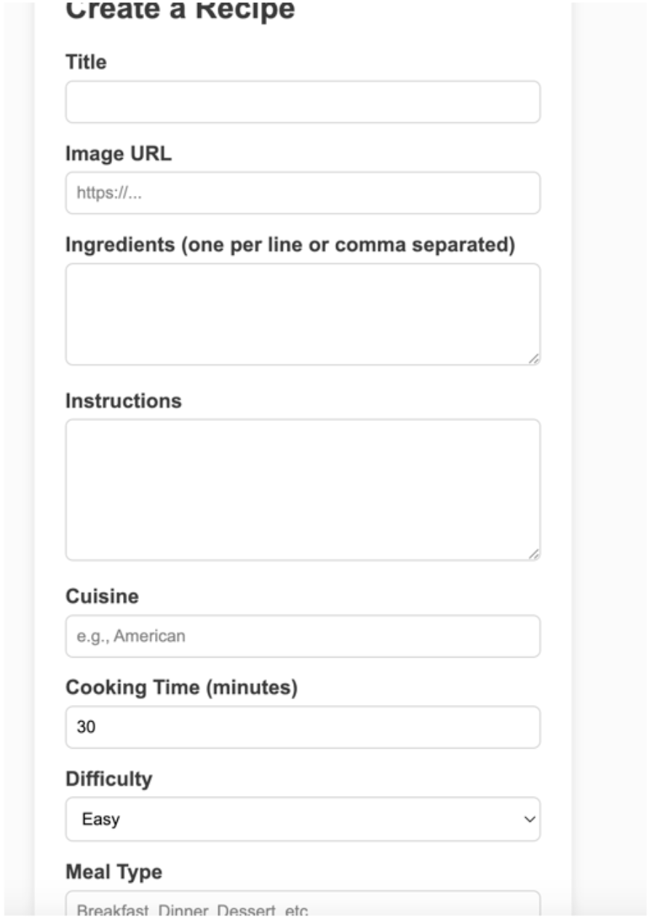
Phase – 2 Deliverables Contd.

Slide 9
Challenges & Solutions
Keeping styling and responses all designed the same
Solution: Use the same font and size for all text
Full testing the UI/UX making sure it was all good
Solution: Looked thoroughly through each screen to ensure everything operates functionally
React Framework Issues
Solution: Our original plan was to develop using a React front-end but struggled with the Backend integration so we switched to Express + EJS

Slide 10
Challenges & Solutions Contd.
View Rendering Issues
Solution: After moving to Express, we struggled with insuring that EJS view files rendered correctly. We had to reorganize the file tree.
Navigation & Page Layout Consistency
Solution: We struggled to get the buttons to look similar in shape and in location spacing so, we created one giant styling sheet.

Slide 11

Project Demonstration

